Slide 1
Lecture 4: Stochastic Thinking and Random Walks

Slide 2

Prof. Grimson Talked about Family Trees
“Yes he loved his mother like no other
His daughter was his sister
And his son was his brother”
Tom Lehrer
“Oedipus Rex”
https://www.youtube.com/watch?v=mScdJURKGWM

Slide 3
Relevant Reading
Pages 235-238
Chapter 14

Slide 4

The World is Hard to Understand
Uncertainty is uncomfortable
But certainty is usually unjustified

Slide 5

Newtonian Mechanics
Every effect has a cause
The world can be understood causally
1643 - 1727

Slide 6
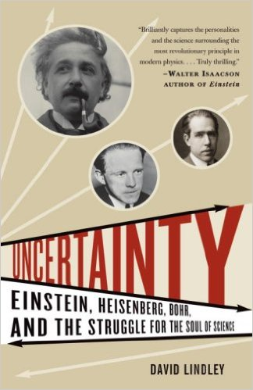
Two Centuries Years Later

Slide 7
Copenhagen Doctrine
Copenhagen Doctrine (Bohr and Heisenberg) of causal nondeterminism
At its most fundamental level, the behavior of the physical world cannot be predicted.
Fine to make statements of the form “x is highly likely to
occur,” but not of the form “x is certain to occur.”
Einstein and Schrödinger objected
“God does not play dice.” -- Albert Einstein

Slide 8
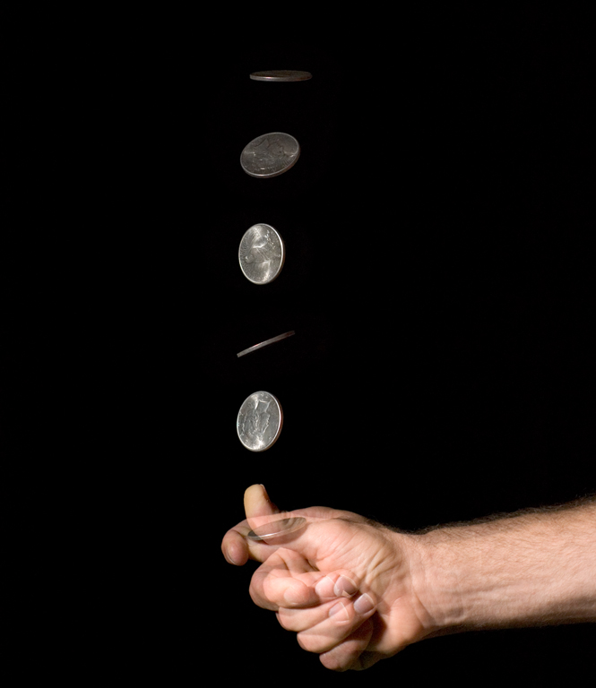
Does It Really Matter
Did the flips yield
2 heads
2 tails
1 head and 1 tail?

Slide 9
The Moral
The world may or may not be inherently unpredictable
But our lack of knowledge does not allow us to make accurate predictions
Therefore we might as well treat the world as inherently unpredictable
Predictive nondeterminism

Slide 10
Stochastic Processes
An ongoing process where the next state might depend on both the previous states and some random element
def rollDie():
""" returns an int between 1 and 6"""
def rollDie():
""" returns a randomly chosen int
between 1 and 6"""

Slide 11
Implementing a Random Process
import random
def rollDie():
"""returns a random int between 1 and 6"""
return random.choice([1,2,3,4,5,6])
def testRoll(n = 10):
result = ''
for i in range(n):
result = result + str(rollDie())
print(result)

Slide 12
Probability of Various Results
Consider testRoll(5)
How probable is the output 11111?

Slide 13
Probability Is About Counting
Count the number of possible events
Count the number of events that have the property of interest
Divide one by the other
Probability of 11111?
11111, 11112, 11113, …, 11121, 11122, …, 66666
1/(6**5)
~0.0001286

Slide 14
Three Basic Facts About Probability
Probabilities are always in the range 0 to 1. 0 if impossible, and 1 if guaranteed.
If the probability of an event occurring is p, the probability of it not occurring must be
When events are independent of each other, the probability of all of the events occurring is equal to a product of the probabilities of each of the events occurring.

Slide 15
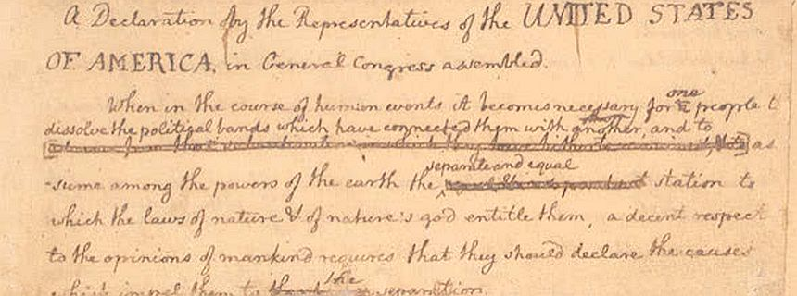
Independence
Two events are independent if the outcome of one event has no influence on the outcome of the other
Independence should not be taken for granted

Slide 16


Will One of the Patriots and Broncos Lose?
Patriots have winning percentage of 7/8, Broncos of 6/8
Probability of both winning next Sunday is 7/8 * 6/8 = 42/64
Probability of at least one losing is 1 – 42/64 = 22/64
What about Sunday, December 18
Outcomes are not independent
Probability of one of them losing is much closer to 1 than to 22/64!

Slide 17
A Simulation of Die Rolling
def runSim(goal, numTrials, txt):
total = 0
for i in range(numTrials):
result = ''
for j in range(len(goal)):
result += str(rollDie())
if result == goal:
total += 1
print('Actual probability of', txt, '=',
round(1/(6**len(goal)), 8))
estProbability = round(total/numTrials, 8)
print('Estimated Probability of', txt, '=',
round(estProbability, 8))
runSim('11111', 1000, '11111')

Slide 18
Output of Simulation
Actual probability = 0.0001286
Estimated Probability = 0.0
Actual probability = 0.0001286
Estimated Probability = 0.0
How did I know that this is what would get printed?
Why did simulation give me the wrong answer?
Let’s try 1,000,000 trials

Slide 19
Morals
Moral 1: It takes a lot of trials to get a good estimate of the frequency of occurrence of a rare event. We’ll talk lots more in later lectures about how to know when we have enough trials.
Moral 2: One should not confuse the sample probability with the actual probability
Moral 3: There was really no need to do this by simulation, since there is a perfectly good closed form answer. We will see many examples where this is not true.
But simulations are often useful.

Slide 20
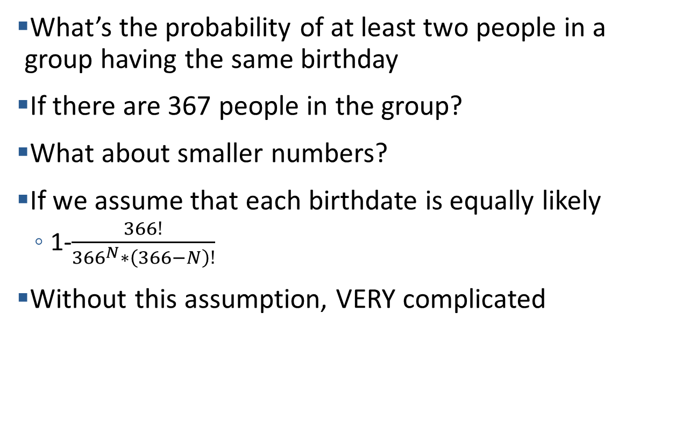
The Birthday Problem
What’s the probability of at least two people in a group having the same birthday
If there are 367 people in the group?
What about smaller numbers?
If we assume that each birthdate is equally likely
1-$\frac{366!}{{366}^{N}∗\left(366−N\right)!}$
Without this assumption, VERY complicated
shoutkey.com/niece

Slide 21
Approximating Using a Simulation
def sameDate(numPeople, numSame):
possibleDates = range(366)
birthdays = [0]*366
for p in range(numPeople):
birthDate = random.choice(possibleDates)
birthdays[birthDate] += 1
return max(birthdays) >= numSame

Slide 22
Approximating Using a Simulation
def birthdayProb(numPeople, numSame, numTrials):
numHits = 0
for t in range(numTrials):
if sameDate(numPeople, numSame):
numHits += 1
return numHits/numTrials
for numPeople in [10, 20, 40, 100]:
print('For', numPeople,
'est. prob. of a shared birthday is',
birthdayProb(numPeople, 2, 10000))
numerator = math.factorial(366)
denom = (366**numPeople)*math.factorial(366-numPeople)
print('Actual prob. for N = 100 =',
1 - numerator/denom)
Suppose we want the probability of 3 people sharing

Slide 23
Why 3 Is Much Harder Mathematically
For 2 the complementary problem is “all birthdays distinct”
For 3 people, the complementary problem is a complicated disjunct
All birthdays distinct or
One pair and rest distinct or
Two pairs and rest distinct or
…
But changing the simulation is dead easy

Slide 24
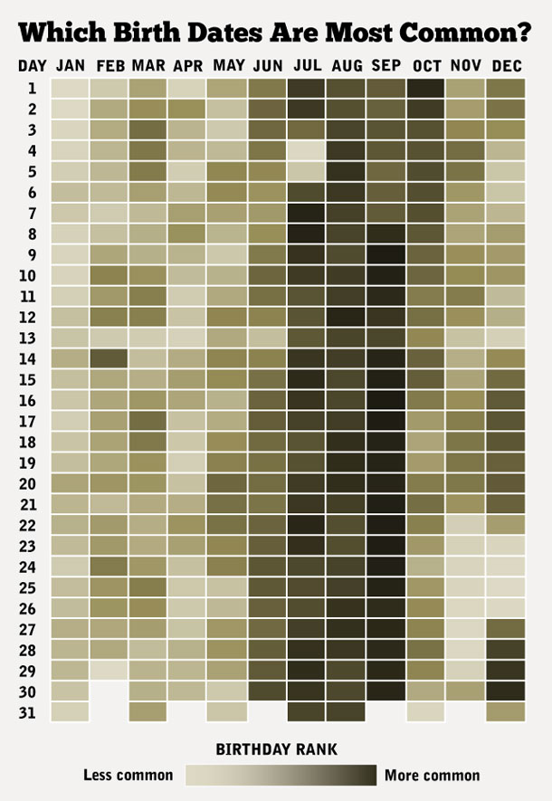
But All Dates Are Not Equally Likely
Are you exceptional?

Slide 25
Another Win for Simulation
Adjusting analytic model a pain
Adjusting simulation model easy
def sameDate(numPeople, numSame):
possibleDates = 4*list(range(0, 57)) + [58]\
+ 4*list(range(59, 366))\
+ 4*list(range(180, 270))
birthdays = [0]*366
for p in range(numPeople):
birthDate = random.choice(possibleDates)
birthdays[birthDate] += 1
return max(birthdays) >= numSame

Slide 26
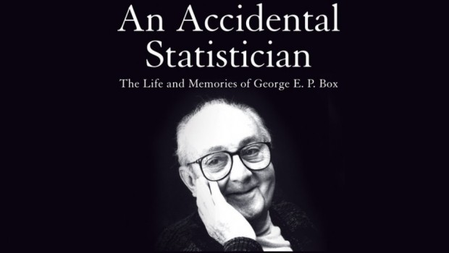
Simulation Models
A description of computations that provide useful information about the possible behaviors of the system being modeled
Descriptive, not prescriptive
Only an approximation to reality
“All models are wrong, but some are useful.” – George Box

Slide 27
Simulations Are Used a Lot
To model systems that are mathematically intractable
To extract useful intermediate results
Lend themselves to development by successive refinement and “what if” questions
Start by simulating random walks

Slide 28
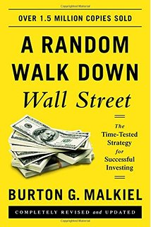
Why Random Walks?
Random walks are important in many domains
Understanding the stock market (maybe)
Modeling diffusion processes
Etc.
Good illustration of how to use simulations to understand things
Excuse to cover some important programming topics
Practice with classes
More about plotting

Slide 29
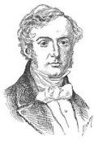
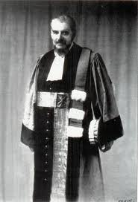
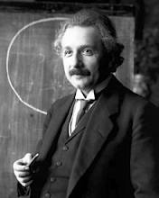
Brownian Motion Is a Random Walk
Robert
Brown
1827
Louis
Bachelier
1900
Albert
Einstein
1905

Slide 30


Drunkard’s Walk

Slide 31
One Possible First Step

Slide 32
Another Possible First Step

Slide 33
Yet Another Possible First Step

Slide 34
Last Possible First Step

Slide 35
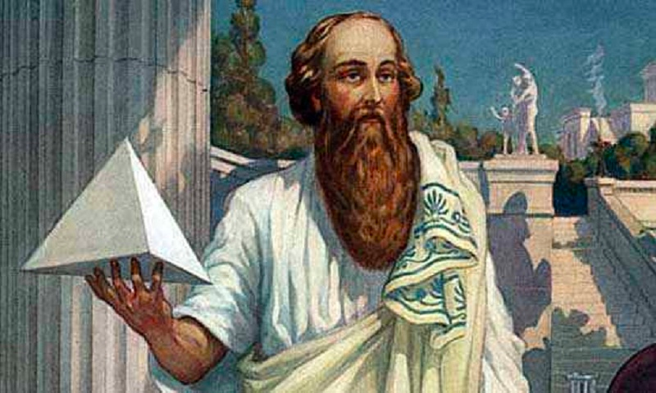
Possible Distances After Two Steps
Notes:
Draw in 0, 2, sqrt(2) = 1.41.4
Average = 1.21

Slide 36
Expected Distance After 100,000 Steps?
Need a different approach to problem
Will use simulation
But not until the next lecture

